Slide 1
My Totem Pole
Natashia Crutcher

Slide 2
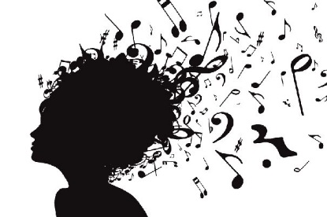
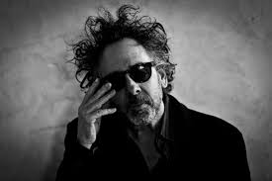
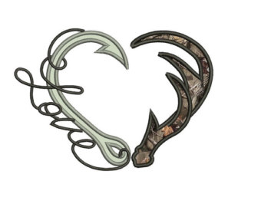
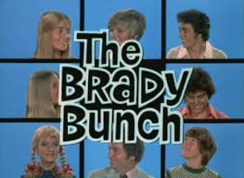

Slide 3
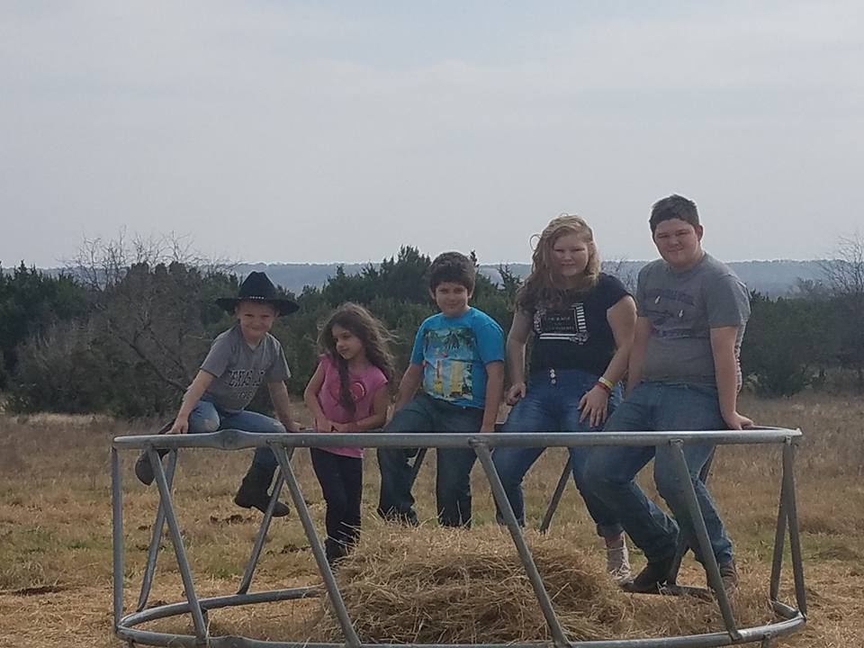
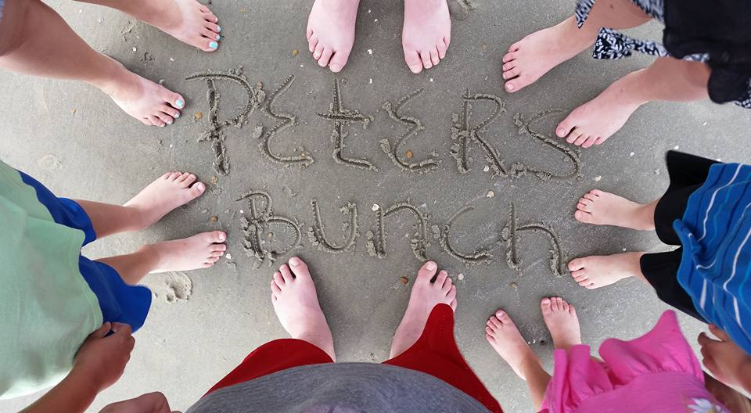
The Brady Bunch
I have 2 kids
My boy friend has 3 kids
Together, we are a family of 7
We call ourselves: The Peters Bunch

Slide 4
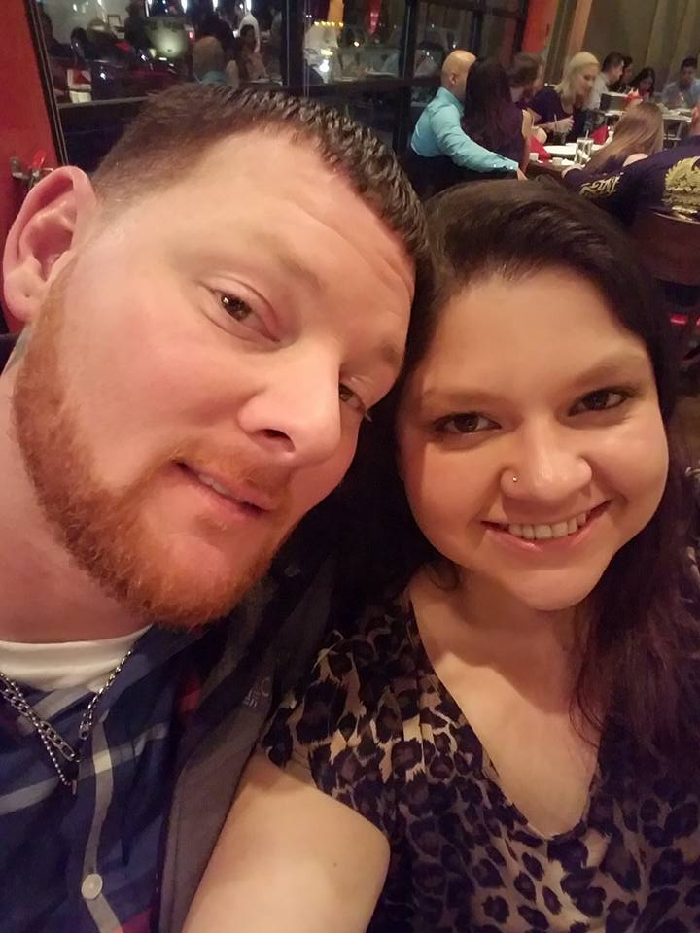
Her Buck, His Doe
My boyfriend and I love to hunt
He introduced me to it
This has become our saying

Slide 5
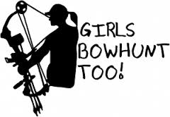
The Heart
The antler represents my love for hunting
The hook represents my love for fishing
I have a necklace with the same image

Slide 6
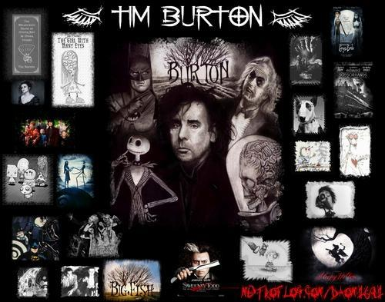
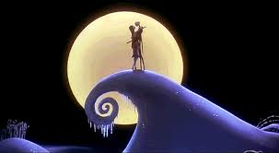
Tim Burton
I am a huge fan of Tim Burton
I love all of his movies
My favorite is The Nightmare Before Christmas

Slide 7
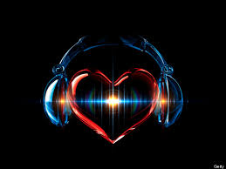
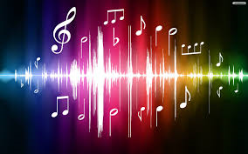
Music
Music is very important to me
I enjoy all genres of music
Music frees my mind and heals my soul

