Slide 1
Jeopardy
Math Version 2.0

Slide 2
Algebraic Equations | Geometry | Trigonometry | Angles
$200 | $200 | $200 | $200
$400 | $400 | $400 | $400
$600 | $600 | $600 | $600
$800 | $800 | $800 | $800
$1000 | $1000 | $1000 | $1000

Slide 3
The product of 9 and a number

Slide 4
9x

Slide 5
The sum of 5 more than twice a number

Slide 6
5 + 2X

Slide 7
4 less than the product of 3 and a number

Slide 8
3x - 4

Slide 9
Twice the sum of 6 and one half of a number

Slide 10
2(6 + ½ x)

Slide 11
the product of a number and 7 less than the same number

Slide 12
X(x-7)

Slide 13
Lines that intersect to form a right angle

Slide 14
Perpendicular lines

Slide 15
two lines that are always the same distance apart and never intersect

Slide 16
Parallel lines

Slide 17
Part of a line

Slide 18
Line segment

Slide 19
Has one endpoint and then continues forever in one direction

Slide 20
A ray

Slide 21
The number of points needed to name a plane

Slide 22
three

Slide 23
Opposite hypotenuse

Slide 24
sine

Slide 25
Adjacent hypotenuse

Slide 26
cosine

Slide 27
Opposite adjacent

Slide 28
tangent

Slide 29
The interior angles of a triangle add up to

Slide 30
180 degrees

Slide 31
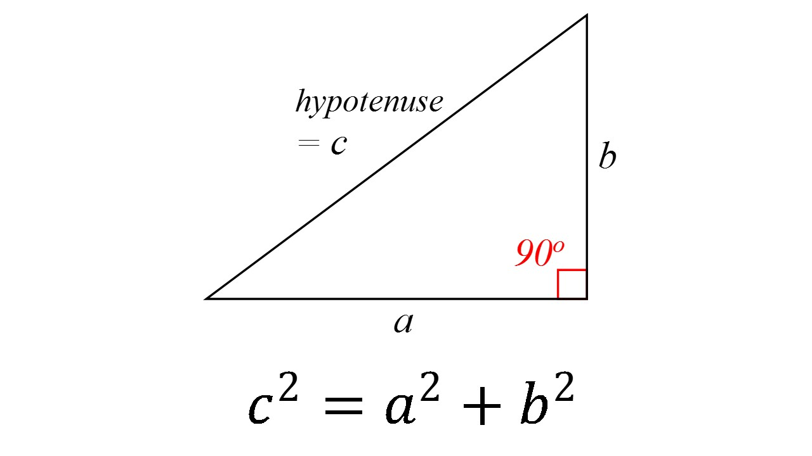
this theorem is known as

Slide 32
Pythagorean theorem

Slide 33
An angle less than 90 degrees

Slide 34
An acute angle

Slide 35
An angle that is exactly 90 degrees

Slide 36
A right angle

Slide 37
An angle that is between 90 and 180 degrees

Slide 38
An obtuse angle

Slide 39
An angle that is exactly 180 degrees

Slide 40
A straight angle

Slide 41
An angle that is between 180 and 360 degrees

Slide 42
A reflex angle

